Slide 1
Logic Building in Programming
By Inderpreet Singh Walia

Slide 2
An introduction to Flowcharts
Flowchart is a graphical representation of an algorithm. Programmers often use it as a program-planning tool to solve a problem. It makes use of symbols which are connected among them to indicate the flow of information and processing.
The process of drawing a flowchart for an algorithm is known as “flowcharting”.

Slide 3
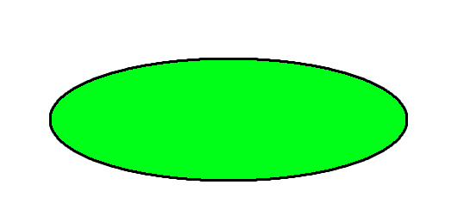
Basic Symbols used in Flowchart Designs
Terminal: The oval symbol indicates Start, Stop and Halt in a program’s logic flow. A pause/halt is generally used in a program logic under some error conditions. Terminal is the first and last symbols in the flowchart.

Slide 4
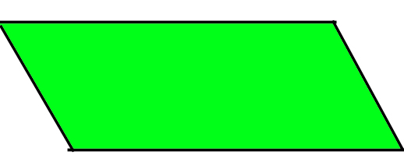
2. Input/Output: A parallelogram denotes any function of input/output type. Program instructions that take input from input devices and display output on output devices are indicated with parallelogram in a flowchart.

Slide 5
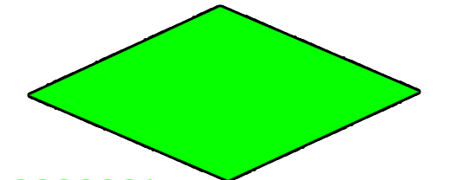
3.Decision: Diamond symbol represents a decision point. Decision based operations such as yes/no question or true/false are indicated by diamond in flowchart.

Slide 6
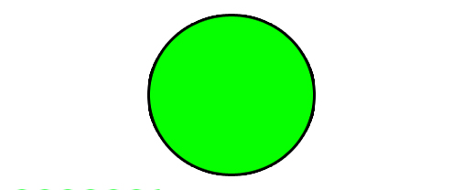
4. Connectors: Whenever flowchart becomes complex or it spreads over more than one page, it is useful to use connectors to avoid any confusions. It is represented by a circle.

Slide 7
5. Process:A box that represents arithmetic instructions. All processes such as adding,subtracting and multiplication.

Slide 8

6.Flow lines: Flow lines indicate the exact sequence in which instructions are executed. Arrows represent the direction of flow of control and relationship among different symbols of flowchart.

Slide 9
Advantages of Flowchart
Flowcharts are better way of communicating the logic of system.
Flowcharts act as a guide for blueprint during program designed.
Flowcharts helps in debugging process.
With the help of flowcharts programs can be easily analyzed.
It provides better documentation.
Flowcharts serve as a good proper documentation.

Slide 10
Disadvantages of Flowchart
It is difficult to draw flowchart for large and complex programs.
In this their is no standard to determine the amount of detail.
Difficult to reproduce the flowcharts.
It is very difficult to modify the Flowchart

Slide 11
Control Structures in Programming Languages
Control Structures are just a way to specify flow of control in programs. Any algorithm or program can be more clear and understood if they use self-contained modules called as logic or control structures. It basically analyzes and chooses in which direction a program flows based on certain parameters or conditions. There are three basic types of logic, or flow of control, known as:
Sequence logic, or sequential flow
Selection logic, or conditional flow
Iteration logic, or repetitive flow

Slide 12
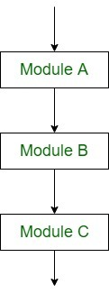
1.Sequential Logic (Sequential Flow):Sequential logic as the name suggests follows a serial or sequential flow in which the flow depends on the series of instructions given to the computer. Unless new instructions are given, the modules are executed in the obvious sequence. The sequences may be given, by means of numbered steps explicitly.

Slide 13
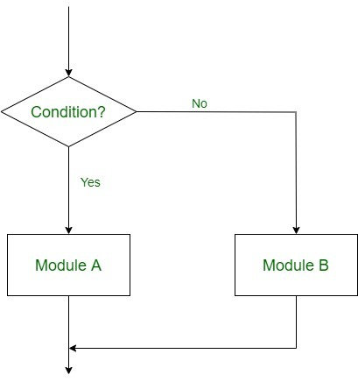
2.Selection Logic (Conditional Flow:Selection Logic simply involves a number of conditions or parameters which decides one out of several written modules. The structures which use these type of logic are known as Conditional Structures. These structures can be of three types:

Slide 14
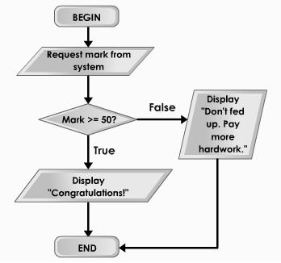
2.Selection Logic Example

Slide 15
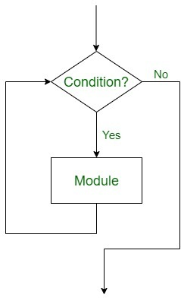
3. Iteration Logic (Repetitive Flow)
The Iteration logic employs a loop which involves a repeat statement followed by a module known as the body of a loop.

Slide 16
Iteration Logic (Repetitive Flow)
Iteration is the process of repeating steps.
For example, a very simple algorithm for eating breakfast cereal might consist of these steps:
put cereal in bowl
add milk to cereal
spoon cereal and milk into mouth
repeat step 3 until all cereal and milk is eaten
rinse bowl and spoon
The algorithm will repeat steps 3 and 4 until all the cereal and milk has been eaten.

Slide 17
Examples of flowcharts in programming
Q.1 Add two numbers entered by the user.
Q 2. Find the largest among three different numbers entered by the user.
Q 3. Find all the roots of a quadratic equation ax2+bx+c=0

Slide 18
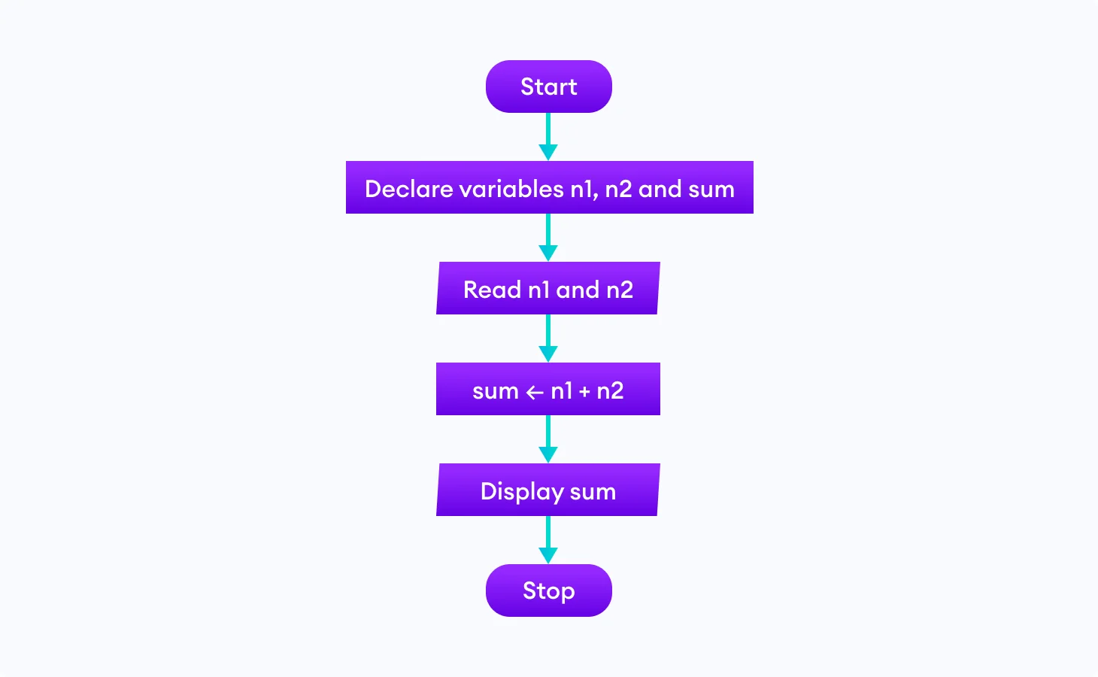
Q1. Add two numbers entered by the user.

Slide 19
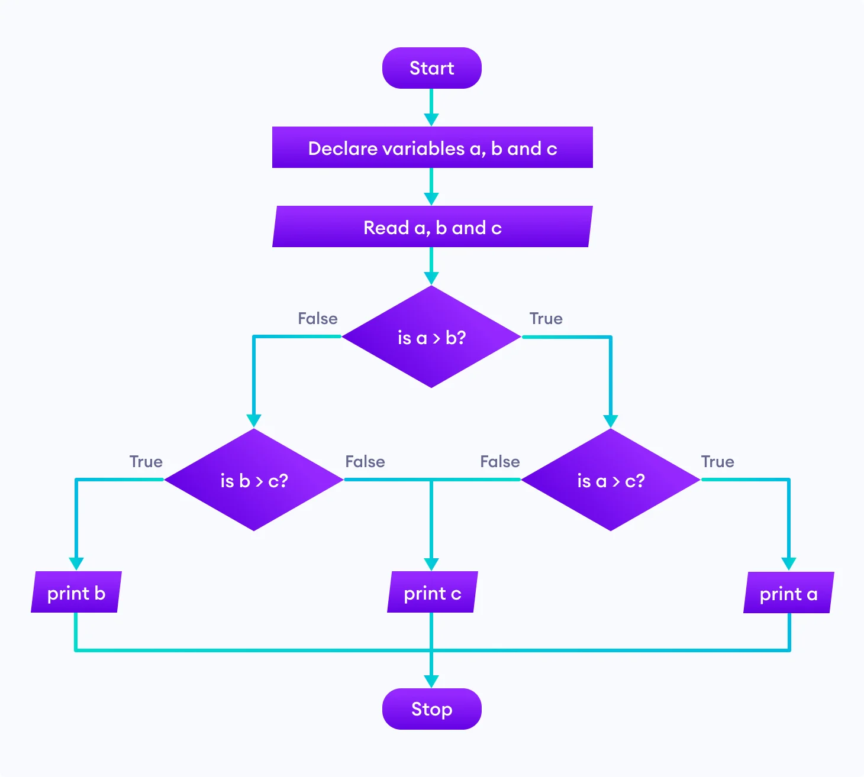
Q2. Find the largest among three different numbers entered by the user.

Slide 20
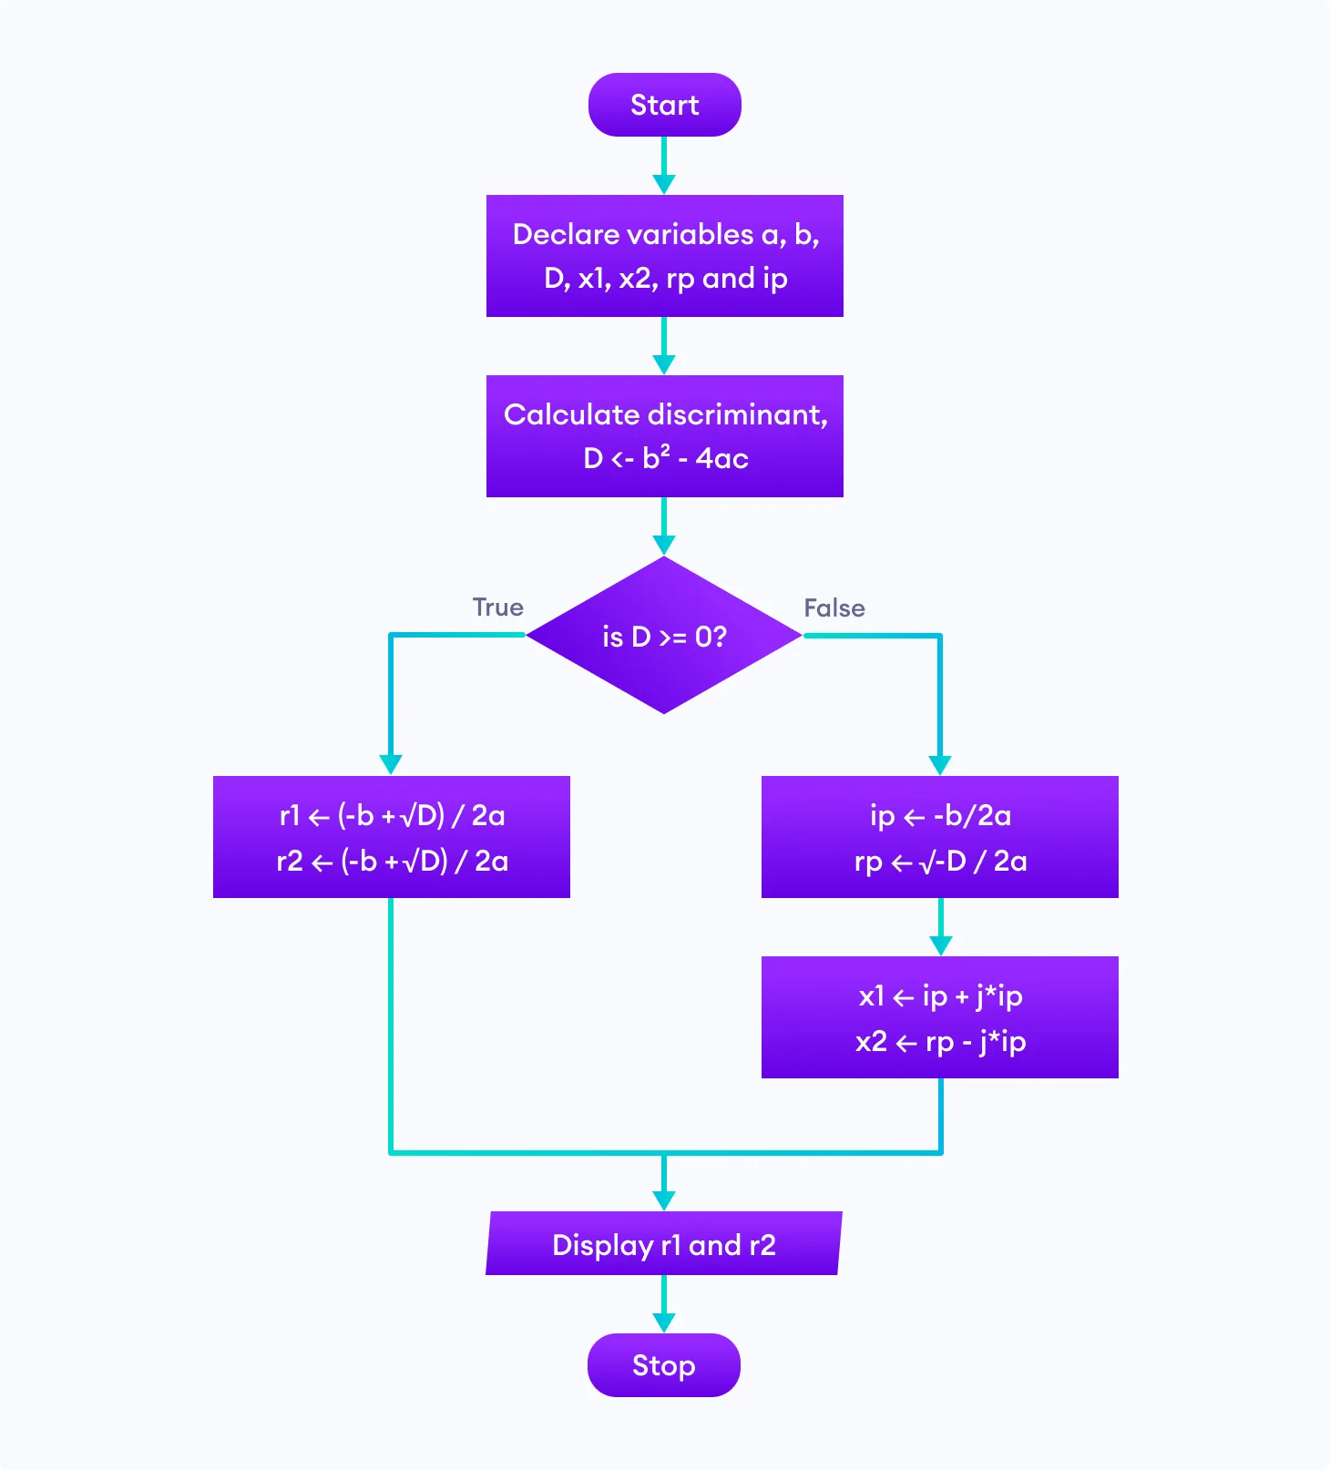
Q3. Find all the roots of a quadratic equation ax2+bx+c=0

Slide 21
Homework Question
Draw a flowchart to print the first 5 common multiples of 3 and 5
For Example—-->15,30,45,60,75

